Slide 1
LECTURE ID :18B11CS311STL07 PROGRAMME : B.Tech. COURSE TITLE : Computer Networks and Internet of Things LECTURE TITLE : Data Communications and Networks FACULTY NAME : Dr. Shobhit Tyagi

Slide 2
Data Communications and Networks
By Dr. Shobhit Tyagi Dept. of CSE & IT JIIT, NOIDA

Slide 3
Topics of Today’s Lecture
IPv4 – Subnetting
IPv4 – Supernetting

Slide 4
High-level Data Link Control
High-level Data Link Control (HDLC) is a set of communication protocols used at the data link layer to send data between network points or nodes.
Since, it is a data link protocol, data is arranged into frames.
These frame are sent through the network, and destination that verifies its successful arrival.
It is a bit-oriented protocol that is applicable for both point-to-point and multipoint communications.
Transfer Modes
HDLC supports two types of transfer modes, normal response mode and asynchronous balanced mode.

Slide 5
High-level Data Link Control
Normal Response Mode (NRM):
Two types of stations are there, a primary station that sends commands and secondary station that responds to received commands. It is used for both, point-to-point and multipoint communications.

Slide 6

High-level Data Link Control
Normal Response Mode (NRM):
Primary Station
Secondary Station
Command
Response
Point-to-point communication
Secondary Stations
Primary Station
Command
Response
Response
Multipoint communication

Slide 7
High-level Data Link Control
Asynchronous Balanced Mode (ABM):
The configuration is balanced, i.e., each station can do both, send commands and respond to commands. It is used for only point-to-point communication.
Station
Station
Command/Response
Command/Response

Slide 8
High-level Data Link Control
HDLC Frame
HDLC is a bit-oriented protocol where each frame contains up to six fields. The structure varies according to the type of frame.
Flag | Address | Control | Payload | FCS | Flag
1 Byte
(01111110)
1 Byte
1 Byte
variable
2 or 4 Byte
1 Byte
(01111110)

Slide 9
High-level Data Link Control
The fields of a HDLC frame are:
Flag: It is an 8-bit sequence that marks the beginning and the end of the frame.
The bit pattern of the flag is 01111110.
Address: It contains the address of the receiver. If the frame is sent by the primary station, it contains the address(es) of the secondary station(s). If it is sent by the secondary station, it contains the address of the primary station. The address field may be from 1 byte to several bytes.
Flag | Address | Control | Payload | FCS | Flag
1 Byte
(01111110)
1 Byte
1 Byte
variable
2 or 4 Byte
1 Byte
(01111110)

Slide 10
High-level Data Link Control
Control:
It is 1 or 2 bytes containing flow and error control information.
Payload:
This carries the data from the network layer. Its length may vary from one network to another.
FCS:
It is a 2 byte or 4 bytes frame check sequence for error detection. The standard code used is CRC (cyclic redundancy code)
Flag | Address | Control | Payload | FCS | Flag
1 Byte
(01111110)
1 Byte
1 Byte
variable
2 or 4 Byte
1 Byte
(01111110)

Slide 11
Types High-level Data Link Control Frames
The type of frame is determined by the control field of the frame :
I-frame or information frames carry user data from the network layer. They also include flow and error control information that is piggybacked on user data. The first bit of control field of I-frame is 0.
S-frame or supervisory frames do not contain information field. They are used for flow and error control when piggybacking is not required. The first two bits of control field of S-frame is 10.
U-frame or un-numbered frames are used for myriad miscellaneous functions, like link management. It may contain an information field, if required. The first two bits of control field of U-frame is 11.

Slide 12
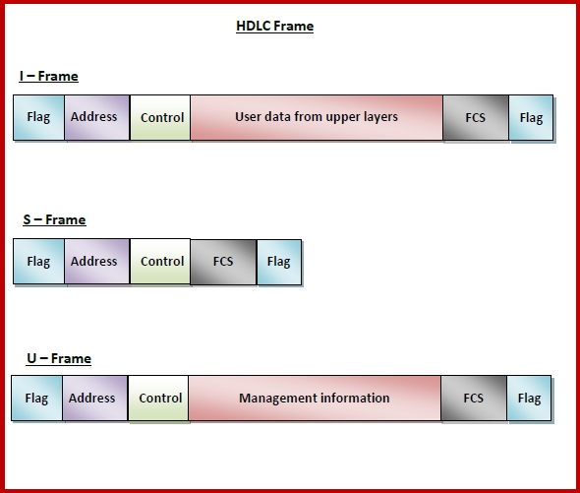
High-level Data Link Control
I-Frame
Flag | Address | Control | User data from upper layers | FCS | Flag
S-Frame
Flag | Address | Control | FCS | Flag
U-Frame
Flag | Address | Control | Management information | FCS | Flag

Slide 13
Time Division Multiplexing (TDM)
Multiplexing is a technique used to combine and send the multiple data streams over a single medium.
The process of combining the data streams is known as multiplexing and hardware used for multiplexing is known as a multiplexer.
Multiplexing is achieved by using a device called Multiplexer (MUX) that combines n input lines to generate a single output line.
Multiplexing follows many-to-one, i.e., n input lines and one output line.

Slide 14
Time Division Multiplexing (TDM)
Demultiplexing is achieved by using a device called Demultiplexer (DEMUX) available at the receiving end.
DEMUX separates a signal into its component signals (one input and n outputs).
Therefore, we can say that demultiplexing follows the one-to-many approach.

Slide 15
Time Division Multiplexing (TDM)
Why Multiplexing?
The transmission medium is used to send the signal from sender to receiver. The medium can only have one signal at a time.
If there are multiple signals to share one medium, then the medium must be divided in such a way that each signal is given some portion of the available bandwidth.
For example:
If there are 10 signals and bandwidth of medium is 100 units, then the 10 unit is shared by each signal.
When multiple signals share the common medium, there is a possibility of collision. Multiplexing concept is used to avoid such collision.
Transmission services are very expensive.

Slide 16
Time Division Multiplexing (TDM)
Multiplexing techniques can be classified as:
Time Division Multiplexing:
In Time Division Multiplexing technique, the total time available in the channel is distributed among different users.
Therefore, each user is allocated with different time interval known as a Time slot at which data is to be transmitted by the sender.
A user takes control of the channel for a fixed amount of time.
In Time Division Multiplexing technique, data is not transmitted simultaneously rather the data is transmitted one-by-one.

Slide 17
Time Division Multiplexing (TDM)
In TDM, the signal is transmitted in the form of frames. Frames contain a cycle of time slots in which each frame contains one or more slots dedicated to each user.
It can be used to multiplex both digital and analog signals but mainly used to multiplex digital signals.

Slide 18
Time Division Multiplexing (TDM)
The Time Division Multiplexing (TDM) is a digital procedure. Here, each sender is given the entire possession of the whole bandwidth of the channel for a fixed duration of time.
After this, the control is moved to the next sender, and the process continues on a round-robin basis.
Example:
In a television serial, generally, a 10 minutes' serial is followed by a 5 minutes' advertisement. The time in which the serial is being broadcasted, the total frequency is dedicated to the serial.

Slide 19
Time Division Multiplexing (TDM)
There are two types of TDM:
Synchronous TDM
Asynchronous TDM

Slide 20
Synchronous Time Division Multiplexing (TDM)
The Synchronous TDM technique is implemented. Each device is allocated with some time slot.
The time slots are transmitted irrespective of whether the sender has data to send or not.
Second Frame
A
A
A
 | B | A
MUX
B
B
 |  | A
C | B | A
Third Frame
First Frame
C

Slide 21
Synchronous Time Division Multiplexing (TDM)
Disadvantages of Synchronous TDM:
The capacity of the channel is not fully utilized as the empty slots are also transmitted which is having no data. In the above figure, the first frame is completely filled, but in the last two frames, some slots are empty. Therefore, we can say that the capacity of the channel is not utilized efficiently.

Slide 22
Asynchronous Time Division Multiplexing (TDM)
An asynchronous TDM is also known as statistical TDM.
An asynchronous TDM is a technique in which time slots are not fixed as in the case of Synchronous TDM. Time slots are allocated to only those devices which have the data to send. Therefore, we can say that Asynchronous Time Division multiplexor transmits only the data from active workstations.
An asynchronous TDM technique dynamically allocates the time slots to the devices.

Slide 23
Asynchronous Time Division Multiplexing (TDM)
In Asynchronous TDM, total speed of the input lines can be greater than the capacity of the channel.
Asynchronous Time Division multiplexor accepts the incoming data streams and creates a frame that contains only data with no empty slots.
In Asynchronous TDM, each slot contains an address part that identifies the source of the data.

Slide 24
Asynchronous Time Division Multiplexing (TDM)
The difference between Asynchronous TDM and Synchronous TDM is that many slots in Synchronous TDM are unutilized, but in Asynchronous TDM, slots are fully utilized. This leads to the smaller transmission time and efficient utilization of the capacity of the channel.
In Synchronous TDM, if there are n sending devices, then there are n time slots. In Asynchronous TDM, if there are n sending devices, then there are m time slots where m is less than n (m<n).
The number of slots in a frame depends on the statistical analysis of the number of input lines.

Slide 25
Time Division Multiplexing (TDM)
There are 4 devices, but only two devices are sending the data, i.e., A and C.
Therefore, the data of A and C are only transmitted through the transmission line.
A
Data
….
B
Idle
C | A | C | A
MUX
Data
C
Idle
D

Slide 26
Frequency Division Multiplexing (FDM)
Frequency division multiplexing (FDM) is a technique of multiplexing which means combining more than one signal over a shared medium.
In FDM, signals of different frequencies are combined for concurrent transmission.

Slide 27
Frequency Division Multiplexing (FDM)
Concept and Process:
In FDM, the total bandwidth is divided to a set of frequency bands that do not overlap.
Each of these bands is a carrier of a different signal that is generated and modulated by one of the sending devices.
The modulated signals are combined together using a multiplexer (MUX) in the sending end.
The frequency bands are separated from one another by strips of unused frequencies called the guard bands, to prevent overlapping of signals.

Slide 28
Frequency Division Multiplexing (FDM)
Concept and Process:
The combined signal is transmitted over the communication channel, thus allowing multiple independent data streams to be transmitted simultaneously.
At the receiving end, the individual signals are extracted from the combined signal by the process of demultiplexing (DEMUX).

Slide 29
Frequency Division Multiplexing (FDM)
It represents multiplexing using FDM. It has 4 frequency bands, each of which can carry signal from 1 sender to 1 receiver.
Output Signals
Input Signals
Frequency Band 1
DEMUX
MUX
Frequency Band 2
Frequency Band 3
Frequency Band 4

Slide 30
Frequency Division Multiplexing (FDM)
Each of the 4 senders is allocated a frequency band. The four frequency bands are multiplexed and sent via the communication channel. At the receiving end, a demultiplexer regenerates the original four signals as outputs.
Output Signals
Input Signals
Frequency Band 1
DEMUX
MUX
Frequency Band 2
Frequency Band 3
Frequency Band 4

Slide 31
Frequency Division Multiplexing (FDM)
If the frequency bands are of 150 KHz bandwidth separated by 10KHz guard bands, then the capacity of the communication channel should be at least 630 KHz (channels : 150 × 4 + guard bands : 10 × 3).
Output Signals
Input Signals
Frequency Band 1
DEMUX
MUX
Frequency Band 2
Frequency Band 3
Frequency Band 4

Slide 32
Frequency Division Multiplexing (FDM)
FDM has been popularly used to multiplex calls in telephone networks. It can also be used in cellular networks, wireless networks and for satellite communications. FDM is used to broadcast FM and AM radio frequencies.
Output Signals
Input Signals
Frequency Band 1
DEMUX
MUX
Frequency Band 2
Frequency Band 3
Frequency Band 4

Slide 33
Frequency Division Multiplexing (FDM)
Grand Bands

Slide 34
Code Division Multiple Access
CDMA stands for Code Division Multiple Access. It is a channel access method which is used by several radio communication technologies.
It is a digital cellular technology and an example of multiple access. It is generally used for mobile communication.
Multiple access means that several transmitters can send information simultaneously over a single communication channel.

Slide 35
Code Division Multiple Access
In this system, different CDMA codes are assigned to different users, and the user can access the whole bandwidth for the entire duration. It optimizes the use of available bandwidth as it transmits over the entire frequency range and does not limit the user's frequency range.
Thus, CDMA allows several users to share a band of frequencies without undue interference between the users. It is used as an access method in many mobile phone standards.
It is based on the spread spectrum technology and makes optimal use of the available bandwidth. Since, it uses the spread spectrum technology, hence allows each user to transmit the data over the entire frequency spectrum at any time.

Slide 36
Code Division Multiple Access
Uses of CDMA:
It is used in the Global Positioning System (GPS).
It is used by several mobile phone companies (e.g. Qualcomm standard IS-2000, also known as CDMA2000)
W-CDMA is used in UTMS 3G mobile phone standard.
CDMA has been used in the OmniTRACS satellite system for transportation.
There is no limit on the number of Users.
It is compatible with other cellular technologies; hence it allows nation-wide roaming.

Slide 37
ALOHA
ALOHA is a multiple access protocol for transmission of data via a shared network channel. It operates in the medium access control sublayer (MAC sublayer) of the open systems interconnection (OSI) model. Using this protocol, several data streams originating from multiple nodes are transferred through a multi-point transmission channel.
In ALOHA, each node or station transmits a frame without trying to detect whether the transmission channel is idle or busy. If the channel is idle, then the frames will be successfully transmitted. If two frames attempt to occupy the channel simultaneously, collision of frames will occur and the frames will be discarded. These stations may choose to retransmit the corrupted frames repeatedly until successful transmission occurs.

Slide 38
ALOHA
ALOHA
Pure ALOHA
Slotted ALOHA

Slide 39
ALOHA
Pure ALOHA, the time of transmission is continuous.
Whenever, a station has an available frame, it sends the frame. If there is collision and the frame is destroyed, the sender waits for a random amount of time before retransmitting it.

Slide 40
Frames in Pure ALOHA
Collison Duration
Collison Duration
Frame 1.1
Frame 1.2
Frame 1.3
Time
Frame 2.1
Time
Frame 2.2
Frame 3.2
Frame 3.1
Time
Frame 4.1
Time
The total vulnerable time of pure Aloha is 2 * Tfr.
Maximum throughput occurs when
G = 1/ 2 that is 18.4%.
Successful transmission of data frame is S = G * e ^ - 2 G.

Slide 41
ALOHA
Slotted ALOHA reduces the number of collisions and doubles the capacity of pure ALOHA. The shared channel is divided into a number of discrete time intervals called slots. A station can transmit only at the beginning of each slot. However, there can still be collisions if more than one station tries to transmit at the beginning of the same time slot.

Slide 42
Frames in Slotted ALOHA
Collison Duration
Collison Duration
Frame 1.1
Time
Frame 2.1
Frame 2.2
Time
Frame 3.1
Frame 3.2
Time
Frame 4.1
Frame 4.2
Time
Slot 1
Slot 2
Slot 3
Slot 4
Slot 5
Slot 6
Maximum throughput occurs in the slotted Aloha when G = 1 that is 37%.
The probability of successfully transmitting the data frame in the slotted Aloha is S = G * e ^ - G.
The total vulnerable time required in slotted Aloha is Tfr.

Slide 43
ALOHA
A group of N stations share 100 Kbps slotted ALOHA channel. Each station output a 500 bits frame on an average of 5000 ms even if previous one has not been sent. What is the required value of N?
Solution:
Throughput of one station-
Throughput of each station
= Number of bits sent per second
= 500 bits / 5000 ms
= 500 bits / (5000 x 10-3 sec)
= 100 bits/sec
Throughput of slotted Aloha-
Throughput of slotted Aloha
= efficiency x bandwidth
= 0.368 x 100 Kbps
= 36.8 Kbps

Slide 44
ALOHA
Total number of stations-
Throughput of slotted Aloha
= Total number of stations x Throughput of each station
Substituting the values, we get,
36.8 Kbps = N x 100 bits/sec
∴ N = 368

Slide 45
ALOHA
Let N station share 60 kbps of slotted aloha channel. Frame size is 1024 bits which are send at every 40 seconds. The value of N is ?
Solution:
Given Bandwidth (B)
= 60 Kbps
= 60*10^3
Bitrate for each host (b)
= 1024/40
= 25.6 b/s
In slotted ALOHA, Number of stations N
= (0.368 * Bandwidth) / Bitrate of each station.
= (0.368 * 60*103) / 25.6
= 862.5 stations

Slide 46

ALOHA
Suppose that the ALOHA protocol is used to share a 56 kbps satellite channel. Suppose that frames are 1000 bits long. Find the maximum throughput of the system in frames/second.
Solution:
The maximum throughput is approximately 10 frames/sec.
$$Maximum throughput for ALOHA=0.184$$
$$Maximum throughput in \frac{frames}{sec}$$
$$=\left(56000 bits/sec\right)×\left(\frac{1 frame}{1000}bits\right)×0.184$$
$$=10.304$$

Slide 47
CSMA
CSMA is a carrier sense multiple access based on media access protocol to sense the traffic on a channel (idle or busy) before transmitting the data.
It means that if the channel is idle, the station can send data to the channel.
Otherwise, it must wait until the channel becomes idle.
Hence, it reduces the chances of a collision on a transmission medium.

Slide 48
CSMA
CSMA Access Modes
1-Persistent:
In the 1-Persistent mode of CSMA that defines each node, first sense the shared channel and if the channel is idle, it immediately sends the data. Else it must wait and keep track of the status of the channel to be idle and broadcast the frame unconditionally as soon as the channel is idle.
Continuously sense
Sense and transit
Time
Busy

Slide 49
CSMA
Non-Persistent:
It is the access mode of CSMA that defines before transmitting the data, each node must sense the channel, and if the channel is inactive, it immediately sends the data. Otherwise, the station must wait for a random time (not continuously), and when the channel is found to be idle, it transmits the frames.
Sense
Sense
Sense and transit
Wait
Wait
Time
Busy

Slide 50
CSMA
P-Persistent:
It is the combination of 1-Persistent and Non-persistent modes. The P-Persistent mode defines that each node senses the channel, and if the channel is inactive, it sends a frame with a P probability.
If the data is not transmitted, it waits for a (q = 1-p probability) random time and resumes the frame with the next time slot.
Probability does not allow
Outcome transmission
Transmit
Continuously sense
Time Slot
Time Slot
Time Slot
Time
Busy

Slide 51
CSMA/CD
CSMA/CD is a carrier sense multiple access/ collision detection network protocol to transmit data frames. The CSMA/CD protocol works with a medium access control layer.
Therefore, it first senses the shared channel before broadcasting the frames, and if the channel is idle, it transmits a frame to check whether the transmission was successful.
If the frame is successfully received, the station sends another frame.
If any collision is detected in the CSMA/CD, the station sends a jam/ stop signal to the shared channel to terminate data transmission.
After that, it waits for a random time before sending a frame to a channel.

Slide 52
CSMA/CD
How does a station know if its data collide?
Solution:
Consider the above situation. Two stations, A & B.
Propagation Time: Tp = 1 hr
(Signal takes 1 hr to go from A to B)
At time,
t=0, A transmits its data.
t= 30 mins : Collision occurs.
After the collision occurs, a collision signal is generated and sent to both A & B to inform the stations about a collision. Since the collision happened midway, the collision signal also takes 30 minutes to reach A & B.

Slide 53
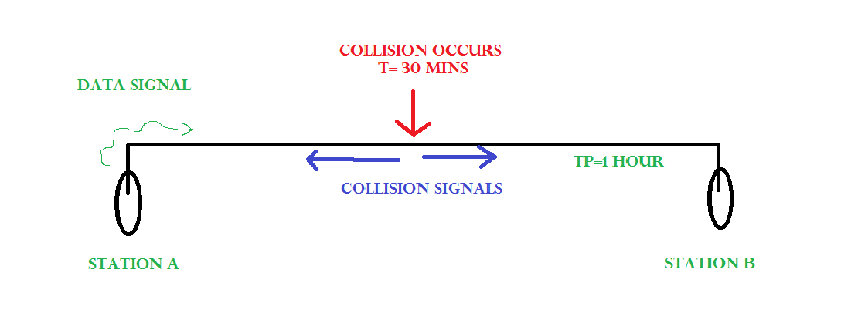
CSMA/CD
Collision Occurs
T=30 mins
Data Signal
TP = 1 hour
Collision Signals
Station A
Station B

Slide 54
CSMA/CD
Therefore, t=1 hr: A & B receive collision signals.
This collision signal is received by all the stations on that link. Then,
How to ensure that it is our station’s data that collided?
Transmission time (Tt) > Propagation Time (Tp) [Rough bound]
This is because, we want that before we transmit the last bit of our data from our station, we should at least be sure that some of the bits have already reached their destination. This ensures that the link is not busy and collisions will not occur.
But, above is a loose bound. We have not taken the time taken by the collision signal to travel back to us. For this consider the worst-case scenario.

Slide 55
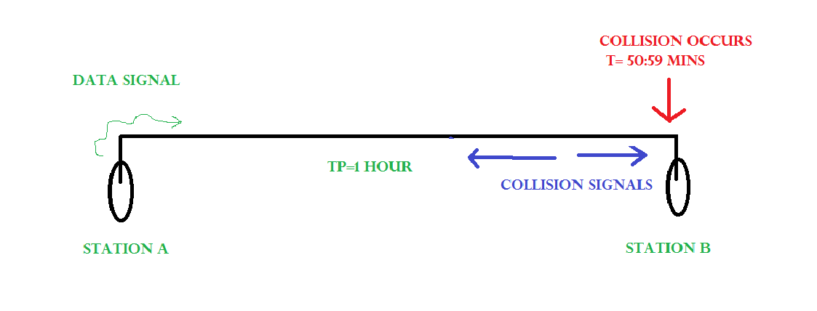
CSMA/CD
Collision Occurs
T= 50.59 mins
Data Signal
TP = 1 hour
Collision Signals
Station A
Station B

Slide 56
CSMA/CD
At time,
t=0, A transmits its data.
t= 59:59 mins : Collision occurs
This collision occurs just before the data reaches B. Now the collision signal takes 59:59 minutes again to reach A.
Hence, A receives the collision information approximately after 2 hours, that is, after 2 * Tp.
Hence, to ensure tighter bound, to detect the collision completely,
Tt > >= 2 * Tp
This is the maximum collision time that a system can take to detect if the collision was of its own data.

Slide 57
CSMA/CD
What should be the minimum length of the packet to be transmitted?
Transmission Time = Tt = Length of the packet/ Bandwidth of the link
[Number of bits transmitted by sender per second]
Substituting above, we get,
Length of the packet/ Bandwidth of the link>= 2 * Tp
$$Length of the packet≥2∗T_{p}∗bandwidth of the link$$

Slide 58
CSMA/CD
Problem:
In a CSMA / CD network running at 1 Gbps over 1 km cable with no repeaters, the signal speed in the cable is 200000 km/sec. What is minimum frame size?
Solution:
Given,
Bandwidth = 1 Gbps
Distance = 1 km
Speed = 200000 km/sec

Slide 59
CSMA/CD
Calculating Propagation Delay:
Propagation delay (Tp)
= Distance / Propagation speed
= 1 km / (200000 km/sec)
= 0.5 x 10-5 sec
= 5 x 10-6 sec
Calculating Minimum Frame Size:
Minimum frame size
= 2 x Propagation delay x Bandwidth
= 2 x 5 x 10-6 sec x 109 bits per sec
= 10000 bits

Slide 60
CSMA/CD
Problem:
A 2 km long broadcast LAN has 10^7 bps bandwidth and uses CSMA / CD. The signal travels along the wire at 2 x 10^8 m/sec. What is the minimum packet size that can be used on this network?
Solution
Given-
Distance = 2 km
Bandwidth = 107 bps
Speed = 2 x 10^8 m/sec
1. Calculating Propagation Delay:
Propagation delay (Tp)
= Distance / Propagation speed
= 2 km / (2 x 108 m/sec)
= 2 x 103 m / (2 x 108 m/sec)
= 10-5 sec
2. Calculating Minimum Frame Size:
Minimum frame size
= 2 x Propagation delay x Bandwidth
= 2 x 10-5 sec x 107 bits per sec
= 200 bits or 25 bytes

Slide 61
IEEE 802 Standards for LAN & WAN
IEEE 802 specifies to a group of IEEE standards. IEEE standards 802 are used for controlling the Local Area Network and Metropolitan Area Network. The user layer in IEEE 802 is serviced by the two layers- the data link layer and the physical layer. The generally uses specifications of IEEE 802 are:
IEEE 802.3 The IEEE 802.3 standard determines the CSMA/CD access control protocol. The best known scheme for controlling a local area network on a bus structure is carrier sense multiple action with collision detection(CSMA/CD).

Slide 62
IEEE 802 Standards for LAN & WAN
IEEE 802.4 IEEE 802.4 describes a token bus LAN standards. In token passing methods, stations connected on a bus are arranged in a logical ring. In this method only the station having token(token holder)is being permitted to transmit frames.
Token Bus network is a standard in which tokens are passed along a virtual ring. In the token bus network bus topology is used as physical media.
IEEE 802.5 IEEE 802.5 describes the token ring standards. In a token ring a special bit pattern, called the token, circulates around the ring whenever all stations are idle. The sequence of token is determined by the physical locations of the stations on the ring.

Slide 63
IEEE 802 Standards for LAN & WAN
802.2 Logical Link Control
The technical definition for 802.2 is “the standard for the upper Data Link Layer sublayer also known as the Logical Link Control layer.
It is used with the 802.3, 802.4, and 802.5 standards (lower DL sublayers).”
802.2 “specifies the general interface between the network layer (IP, IPX, etc) and the data link layer (Ethernet, Token Ring, etc).”
Basically, think of the 802.2 as the “translator” for the Data Link Layer.
802.2 is concerned with managing traffic over the physical network. It is responsible for flow and error control. The Data Link Layer wants to send some data over the network, 802.2 Logical Link Control helps make this possible.
It also helps by identifying the line protocol, like NetBIOS, or Netware.

Slide 64
IEEE 802 Standards for LAN & WAN
IEEE 802.6 standard i.e. DQDB(Distributed Queue Dual Bus) is a MAN(Metropolitan Area Network) protocol.
It can be defined as a high speed shared medium access control protocol that is used over a bus network.
It has two unidirectional buses, for controlling purposes, where the bus can carry data, video, and voice over a network with bandwidth being allocated as per time slots.
The advantage of using the paired bus is that it is used to tackles failure configuration. It can be extended up to 30 miles at 34-55 Mbps.

Slide 65
IEEE 802 Standards for LAN & WAN
IEEE standards in computer networks | Description
IEEE 802 | It is used for the overview and architecture of LAN/MAN.
IEEE 802.1 | It is used for bridging and management of LAN/MAN.
IEEE 802.2 | It is used in Logical Link Control (LLC).
IEEE 802.3 | It is used in Ethernet (CSMA/CD access method).
IEEE 802.4 | It is used for token passing bus access methods and the physical layer specifications.

Slide 66
IEEE 802 Standards for LAN & WAN
IEEE standards in computer networks | Description
IEEE 802.5 | It is used for token ring access methods and the physical layer specifications.
IEEE 802.6 | It is used in distributed Queue Dual Bus (DQDB) access method and for the physical layer specifications (MAN).
IEEE 802.7 | It is used in broadband LAN.
IEEE 802.8 | It is used in fiber optics.
IEEE 802.5 | It is used for token ring access methods and the physical layer specifications.

Slide 67
Thank You

